Slide 1

Generics and Collections
CS 1181 – Computer Science II
Dr. Michael Raymer
Lecture materials adapted from:
ZyBooks ISBN: 979-8-203-16123-9 Dr. Cay Horstmann, Univ. of Michigan Dr. Roman Lysecky, Univ. of Arizona
Dr. Adrian Lizarraga, Univ. of Arizona
Dr. Travis Doom
Dr. Michelle Cheatham
Unless otherwise noted images are used under the creative commons license or used under license from Adobe Stock.

Slide 2
Did you know?
You can make an ArrayList without the <> part?
public static void main(String[] args) {
ArrayList myList = new ArrayList();
myList.add("String");
myList.add(7);
myList.add(new JButton(“Click me"));
for (Object o : myList){
System.out.println(o);
}
}
Why do we add <Class> then?

Slide 3
Generic classes, like ArrayList<T>, allow us to:
Catch type errors early, rather than later
Control what types a container will hold
Avoid extra typecasting
The generic uses one or more reference variables to <T> so any subclass of <T> will work too.

Slide 4
ArrayList<> and subclasses
public static void main(String[] args) {
ArrayList<Number> numbers = new ArrayList<>();
numbers.add(5);
numbers.add(3);
numbers.add(2);
int sum = 0;
for (Number n : numbers){
sum += (Integer) n;
}
System.out.println(sum);
}
Typecasts make assumptions!
What if I put a double into the list?
Notes:
Use Number.doubleValue();
Best to be as specific as possible!
Example: ArrayList full of strings and use toUpperCase()

Slide 5

Creating your own generic class
public class LottoBag<E>
What kind of LottoBag do you want? Integers? Strings?
E is called the Type Parameter, and we can use it in the implementation to talk about what kinds of objects our LottoBag can hold.
Type parameters get to break the rules of good variable naming. E = Element, T = Type.

Slide 6

Should LottoBag contain or extend ArrayList?
Modifier and Type | Method and Description
Boolean | add(E e)Appends the specified element to the end of this list.
Void | add(int index, E element)Inserts the specified element at the specified position in this list.
void | clear()Removes all of the elements from this list.
boolean | contains(Object o)Returns true if this list contains the specified element.
E | get(int index)Returns the element at the specified position in this list.
int | indexOf(Object o)Returns the index of the first occurrence of the specified element in this list, or -1 if this list does not contain the element.
boolean | isEmpty()Returns true if this list contains no elements.
E | remove(int index)Removes the element at the specified position in this list.
int | size()Returns the number of elements in this list.

Slide 7
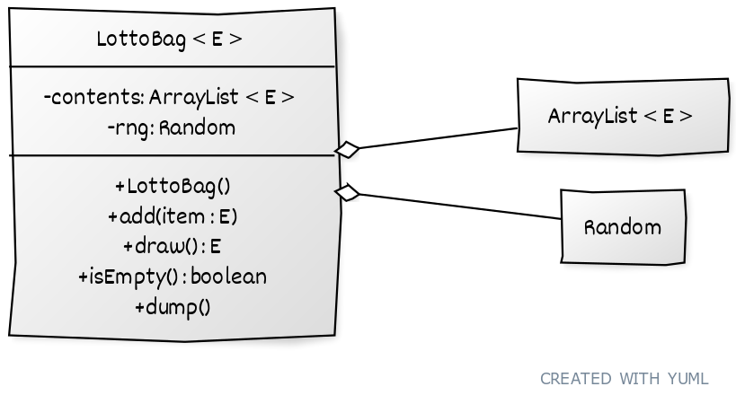
Class LottoBag<E>

Slide 8
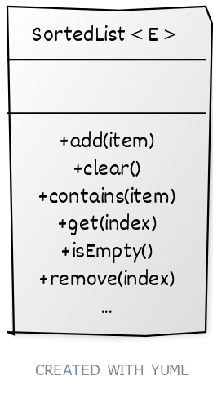
Sometimes we need to limit what kinds of objects can be placed into a generic collection
Should SortedList extend or contain ArrayList?

Slide 9

Bounded type parameters
public class SortedList<E extends Number>
This list can only hold Numbers (and subclasses of Number).
E is a Bounded Type Parameter, limiting what kinds of classes can be used.
The keyword extends is used for everything: regular classes, abstract classes, and interfaces.

Slide 10
Let’s make it a bit more general…
public class SortedList<E extends Comparable<E>>
Anything that implements the Comparable interface
This looks a little complex, because Comparable is itself a Generic Interface. The declaration limits E to “any class that can be compared to itself”.
In other words, Class E must have the method
public boolean compareTo(E otherItem)

Slide 11
The whole thing
public class SortedList<E extends Comparable<E>> extends ArrayList<E>{
@Override
public boolean add(E item){
super.add(item);
Collections.sort(this);
return(true);
}
@Override
public void add(int index, E item){
add(item);
} }
What do we need to add to make this work?

Slide 12
Generic Parameters and Wildcards
Suppose I wanted to add an entire Array of objects to my LottoBag.
I should be able to add an ArrayList<E> or a list of any subclass of E.
Something like:
public void addAll(ArrayList<E> itemList) {…}
Unfortunately… ArrayList<Double> is not a subclass of ArrayList<Number>!

Slide 13
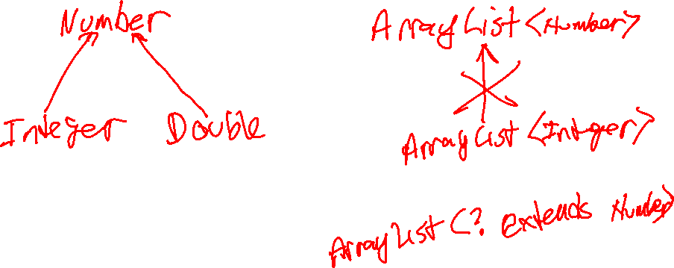

Slide 14
Wildcards
We need a way to say “any subclass of E” in method parameter lists
public void addAll(ArrayList<? extends E> itemList){
itemList is an ArrayList
… of E or any class
… that extends E
Notes:
Only in parameter lists!

Slide 15
Wildcards
We can also say “any superclass of E” in method parameter lists
public void copyAllTo(ArrayList<? super E> itemList){
itemList is an ArrayList
… of E or
… any superclass of E
Notes:
Only in parameter lists!

Slide 16
We can also make generic methods
The type parameter goes right before the return type
public static <T> void printArray(T[] array){
System.out.print("[");
for (int i = 0; i < array.length; i++){
System.out.print(array[i]);
if (i < array.length - 1){
System.out.print(", ");
}
}
System.out.println("]");
}

Slide 17
Things to watch out for
Behind the scenes, Java still creates your generic class as a collection of Objects and typecasts everything to E.
This is called Type Erasure. It usually doesn’t cause trouble, but it can pop up when you are creating new objects of type E.
ArrayList<String> list = new ArrayList<>();
list.add("hello");
String word = list.get(0);
ArrayList list = new ArrayList();
list.add("hello");
String word = (String) (list.get(0));

Slide 18


Check your Understanding
Is this a bounded or an unbounded type parameter? public class Box<E extends Boxable>
Can Boxable be an interface? Can it be an abstract class?
Can I call this method:
public static <E> E foo(E x, double y) like this?
String x = foo("Hello", 3);

Slide 19
Java Collection Interface
Modifier and Type | Method and Description
boolean | add(E e) Add an object to the collection
boolean | addAll(Collection<? extends E> c) Adds all of the elements in the specified collection to this collection (optional operation).
void | clear() Removes all of the elements from this collection.
boolean | contains(Object o) Returns true if this collection contains the specified element.
boolean | isEmpty() Returns true if this collection contains no elements.
E | remove(Object o) Removes the element matching o.
int | size() Returns the number of elements in this collection.
Object[] | toArray() Returns an array containing all of the elements in this collection.
No get() because not all collections have an order. Collections are Iterable.

Slide 20
Java Collections
The Java Collections class has a bunch of static methods to do useful things with collections. For example:
Collections.sort()
Collections.max() & Collections.min()
Collections.reverse()
Collections.shuffle()
Collections.swap()
https://docs.oracle.com/javase/8/docs/api/java/util/Collections.html

Slide 21
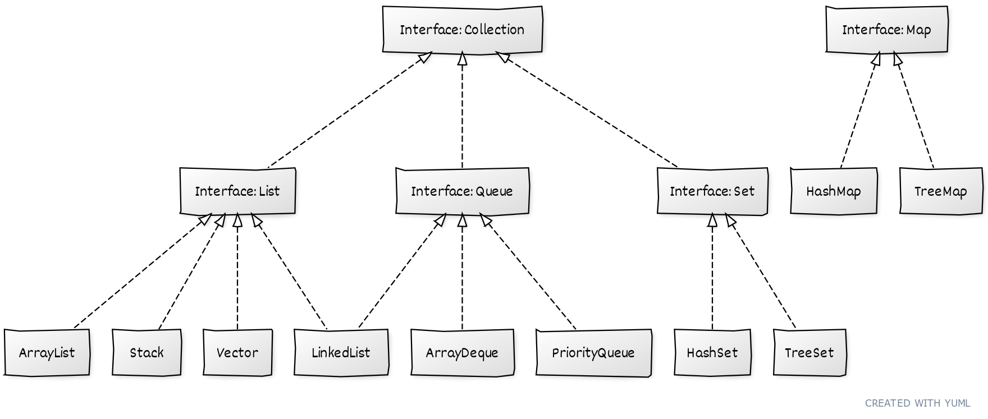
Java collections

